Slide 1
Risk Management
Position Control

Slide 2
POSITION CONTROL Position Value
Single position value can be greater than total funds
Calculate the total position value
Calculate the total leverage
单仓位价值可以比总资金量大
计算总仓位价值
计算总仓位杠杆

Slide 3
POSITION CONTROL Position Value
Single position value
PV = P_{entry} * Size_{symbol} or Size_{Currency}
单仓位价值
仓位价值 = 开仓价 * 开仓数量 或 开仓大小（基础货币）

Slide 4
POSITION CONTROL Position Value
Total position value
PV_{total} = PV₁ + PV₂ + … + PV_{n}
总仓位价值
总价值 = 每个单仓位的价值总和

Slide 5
POSITION CONTROL Position Value
Total position leverage
L_{total} = PV_{total} / Funds
总仓位杠杆
总仓位杠杆 = 总仓位价值 / 总保证金

Slide 6
POSITION CONTROL Leverage and Risk Tolerance
Estimate risk tolerance
1 / L_{total} > %_{-movings}
估计风险承受能力
可承受的综合价格百分比（损失）小于总仓位杠杆的倒数

Slide 7

LEVERAGE TRADING Risk Tolerance
Amplify position value
$PV =\$FundsIn × \#Leverage$
Amplify profit and loss
$PNL=\%Moving × \#Leverage$

Slide 8
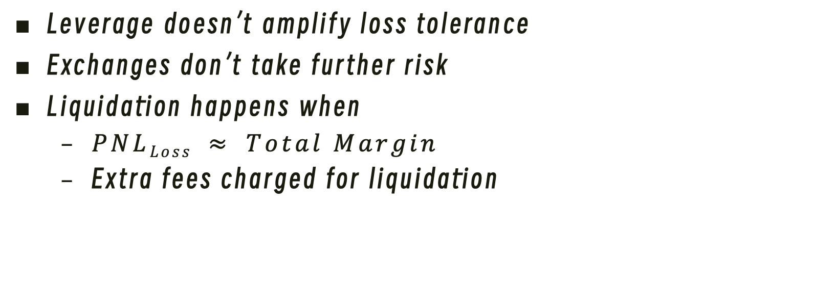
LEVERAGE TRADING Liquidation
Leverage doesn’t amplify loss tolerance
Exchanges don’t take further risk
Liquidation happens when
$PNLLoss ≈ Total Margin$
Extra fees charged for liquidation

Slide 9
LEVERAGE TRADING Fees
Interests and Funding Fees
Periodically (per hour or per 8-hour)
Trading Fees
Each transection (enter or exit)

